Slide 1
Real-Time Data for AI Agents: Grounding with Event-Driven Architecture
Gayathri Narayana, Rashmi Kumari, Vinayak Adkoli
SAP

Slide 2
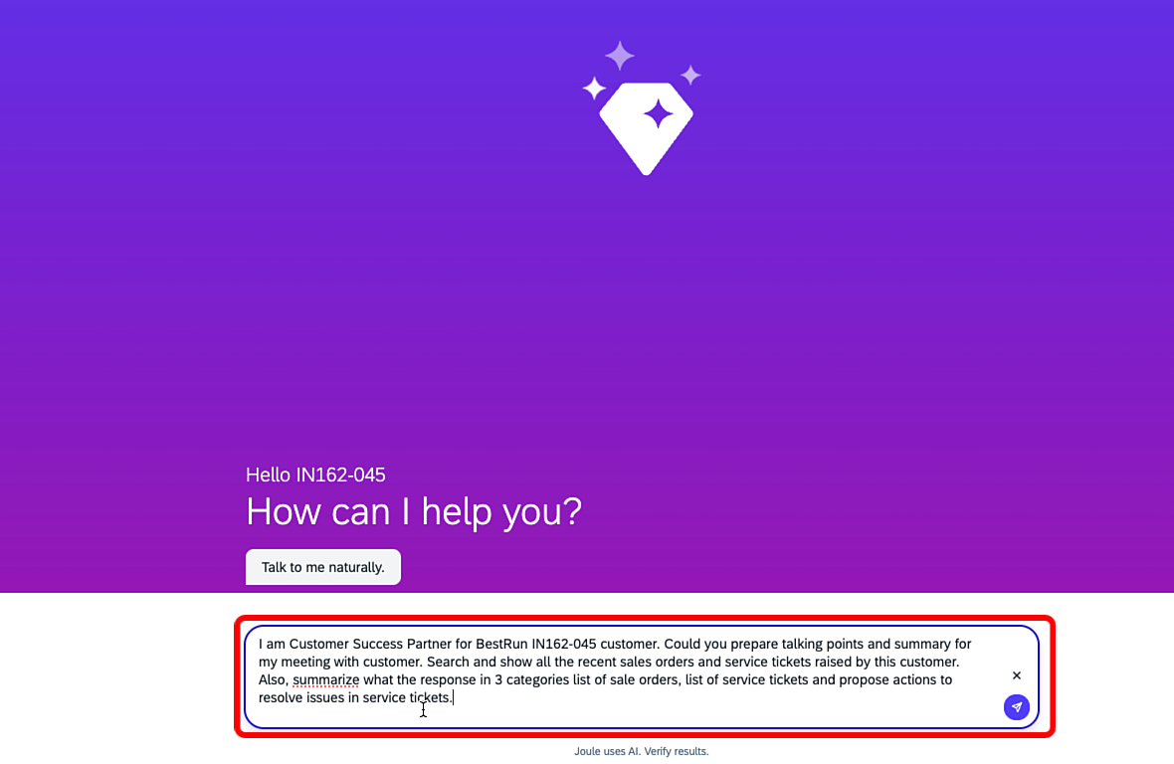
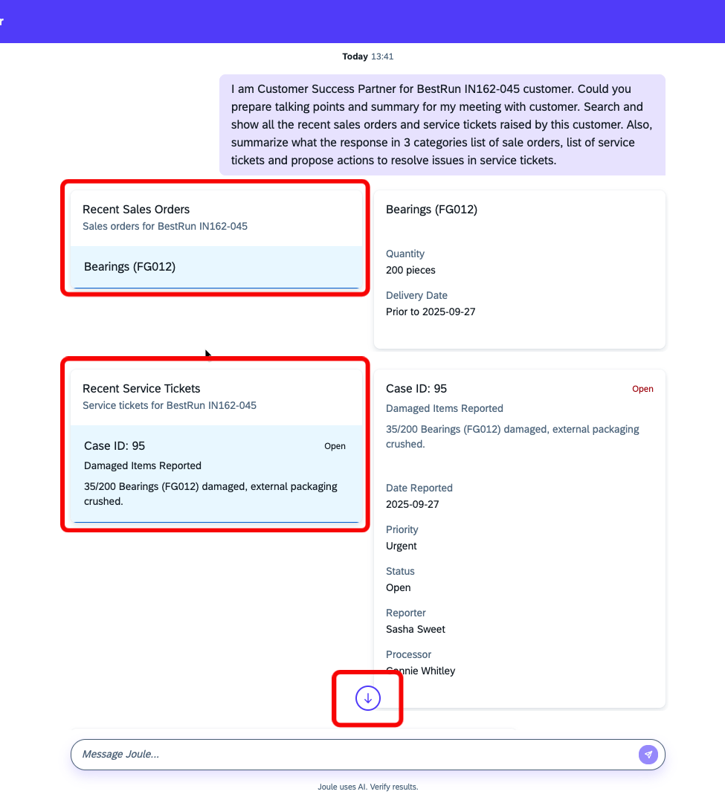
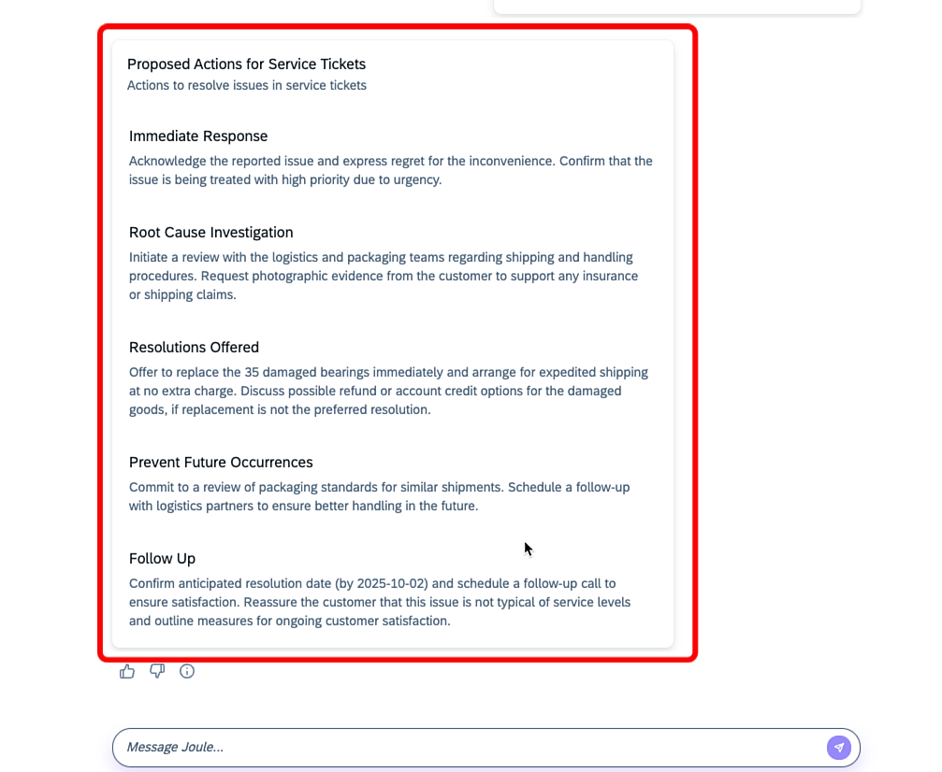

Slide 3
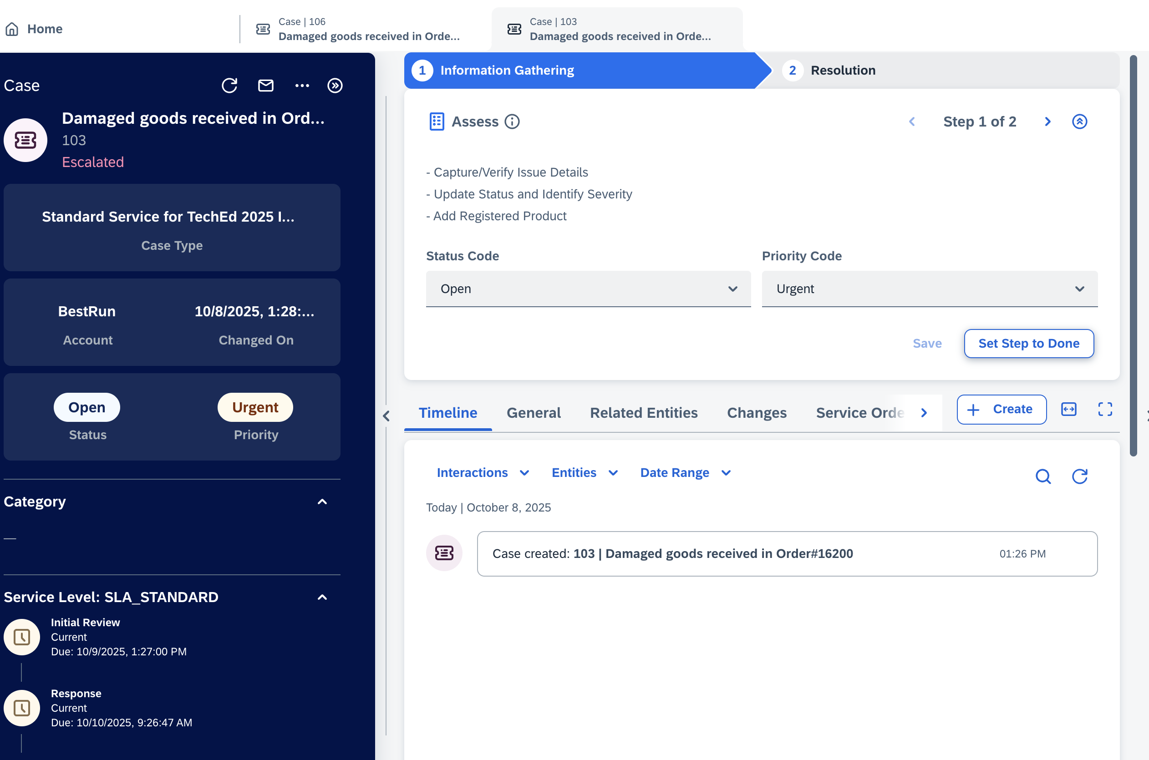
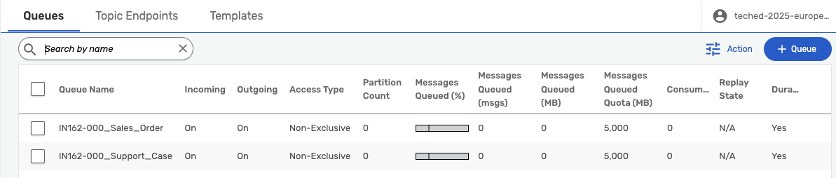
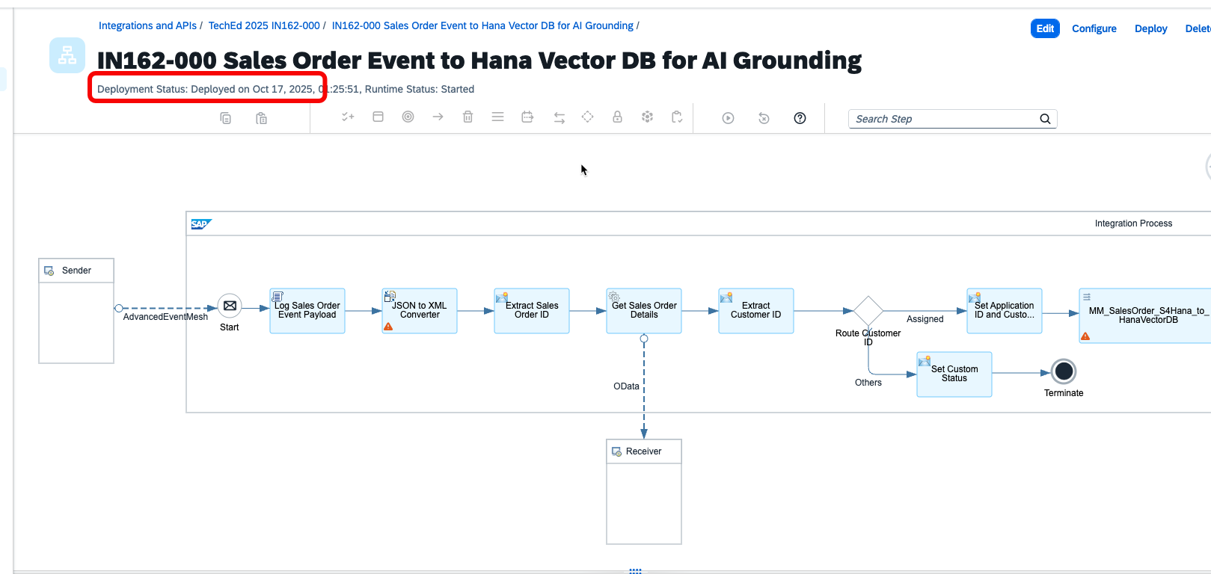
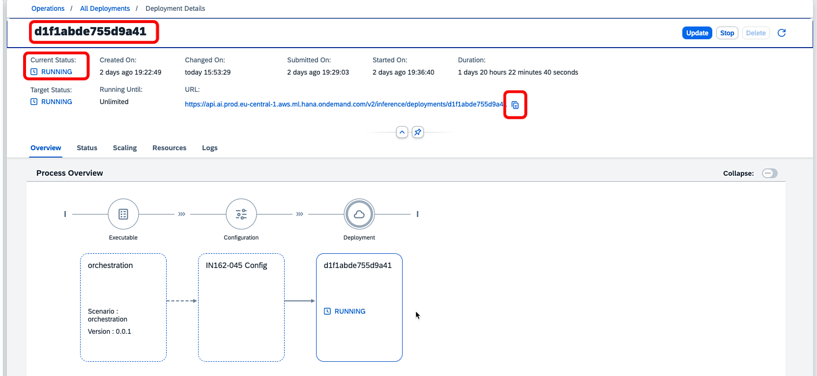
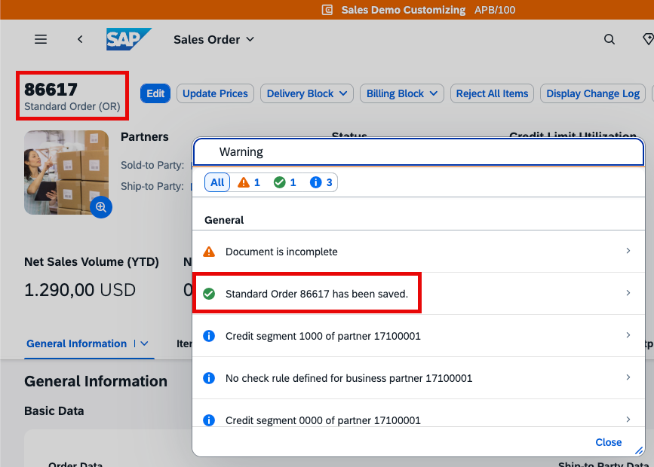
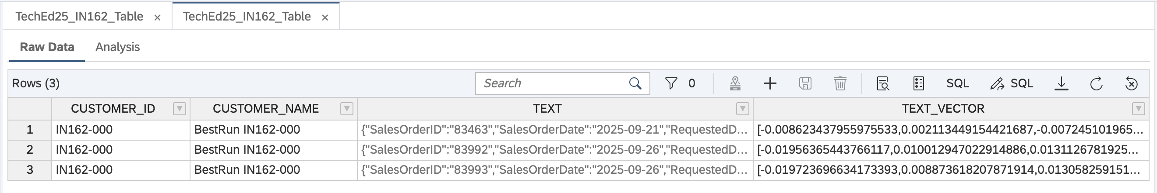

Slide 4
















Legend
SAP Cloud
Solutions
Real-time vector grounding flow
Subaccount
Customer Success Digital Assistant flow
Multi-Cloud
2
SAP AI Launchpad
SAP S/4HANA Cloud
SAP Integration Suite
4
Publish Event
SMF
Create sales order
Embeddings (JSON)
1
SAP Integration Suite, advanced
event mesh
Cloud Integration
SAP AI Core
Embeddings (Prompt)
SAP Service Cloud V2
Publish Event
8
Create support case
3
7
AI API
5
AI Adapter (Summarize)
OData / HTTPS
SAP Build
HTTPS
10
integrated
JDBC
INSERT
6
SAP Build Process Automation
AI Models
Prompt
9
integrated
Customer Success Manager
Joule Application Client
JDBC
SELECT
Mobile or Desktop
Joule Skill
Business User
SAP HANA
Cloud
Authenticate
Application Clients
SAP Cloud Identity Service
Desktop
Notes:
Within the Cloud Integration capability of SAP Integration Suite, two Integration Flows subscribe to new Sales Order and Support Case events via the Cloud Integration Advanced Event Mesh sender adapter, which uses the Solace Message Format (SMF) protocol. Each flow performs lookup calls to SAP S/4HANA Cloud and SAP Service Cloud, version 2, to enrich the event with additional details, applies message mapping, converts the payload to JSON, and then invokes the SAP AI Core API to generate embeddings using the text-embedding-3-small model. These embeddings are stored in an SAP HANA Cloud vector database and used to ground a large language model in real time. This scenario demonstrates real-time vector grounding with SAP HANA Cloud, SAP Integration Suite, and SAP Integration Suite, advanced event mesh—showing how data updates can instantly influence model responses so they remain current and contextually accurate. By the end, you will have an end-to-end, event-driven flow that reacts to new Sales Order events from SAP S/4HANA Cloud and new Support Case events from SAP Service Cloud, version 2, providing rich, real-time context to an AI assistant.

Slide 5
Thank you!
Gayathri Narayana | gayathri.narayana@sap.com
Rashmi Kumari | rashmi.kumari04@sap.com
Vinayak Adkoli | vinayak.adkoli@sap.com

Slide 6
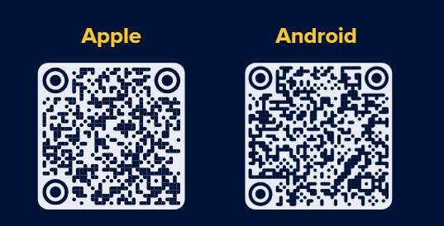
Thank you!
Enjoyed this session?
Open the app and leave a review!
Don’t have the app?
Scan the QR codes to download it.
Want all the slide decks?
Complete the event survey—we’ll send the survey to your email AFTER the event.

